Slide 1
Dynamic Q/A System
By INNOVATORS 2.0
Shankar Pentyala
Nageshwar rao Nandigam
Revanth Chakilam
Syed Moin
“It is worth exploring the exciting field of question answering”

Slide 2
Motivation
We the Team Innovators 2.0 are in a search of data and knowledge. We have a lot of difference between information and knowledge. When we speak about Information a semantic google search is more improvised and we can retrieve relevant information sitting in home.
“Question Answering” is a dynamic way of retrieving Information, which learns knowledge.
The main focus is particular in obtaining the respective documents but also particular in obtaining the respective response to query we post.
Question and Answer system is capable of performing the NLP Processing, Information gathering, topic discovery, Machine Learning and Sematic Search.
Question and answer system itself is the beauty of NLP and same instance have a bit of science in its essence.

Slide 3
Problem statement
We want to design and implement a question answering system that is capable of answering questions in English and provide a refined set of results ordered by relevancy to the question asked. The challenge is to provide accurate answer to the user in a timely fashion with a design approach. The design and implementation of the question answering system consists of the process of question parsing, query modulation, document retrieval, answer extraction and answer ranking.

Slide 4
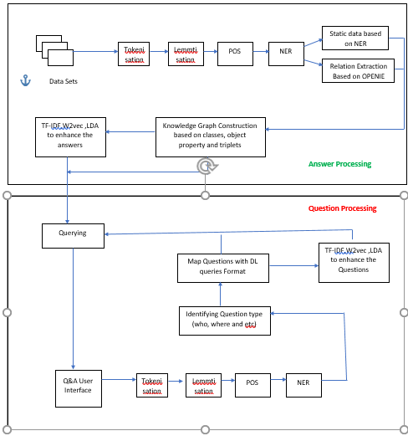
Solution - Architecture

Slide 5
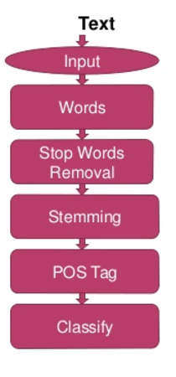
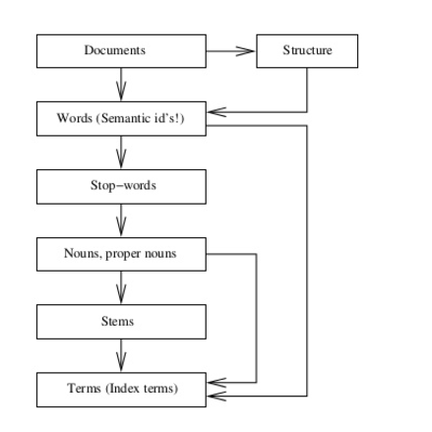
Solution - Workflow

Slide 6
Data sets
BBC Sports
Greek Elections DataSet
EarthQuakes Dataset

Slide 7
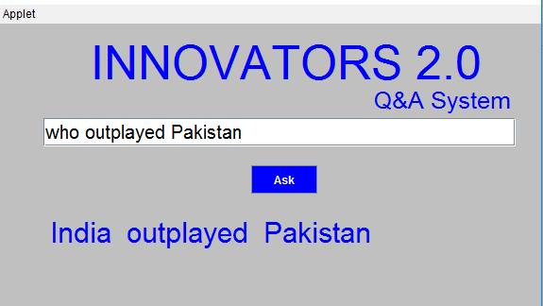
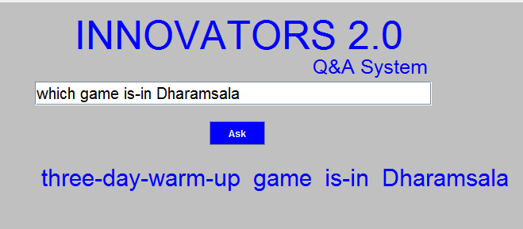
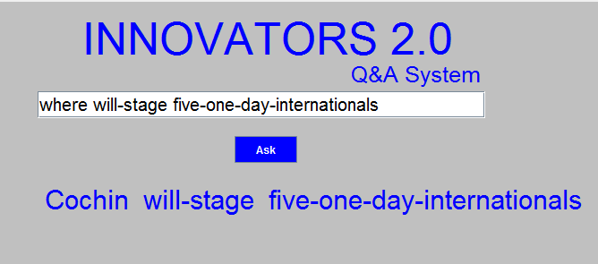
Results-BBC Sports

Slide 8
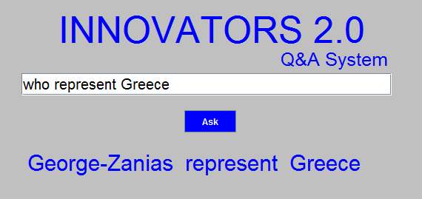
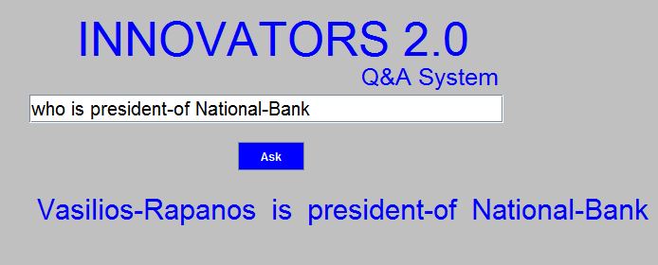
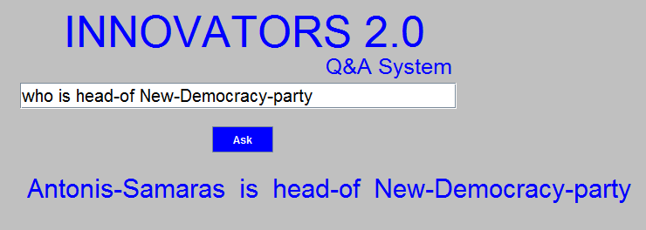
Results-Greek Elections

Slide 9
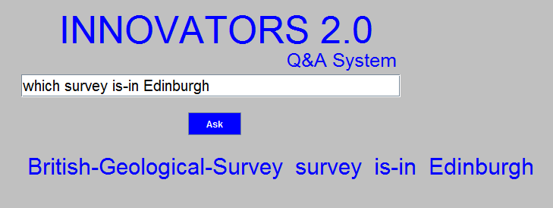
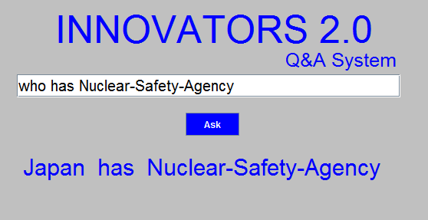
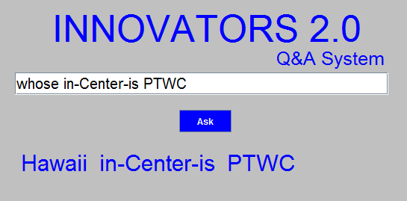
Results- EarthQuakes

Slide 10
Drawbacks
Junk values in raw data
Incapable of answering questions having two predicates
Processing only text format data

Slide 11
Future Scope
Multi Modal System
Multi Lingual System
Handling all type of Questions
Processing huge data sets

Slide 12
Thank you

